Slide 1
Internet of Things

Slide 2
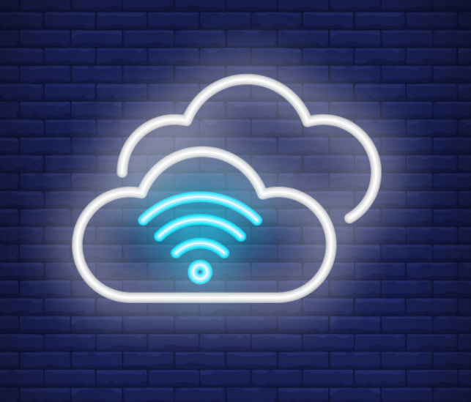
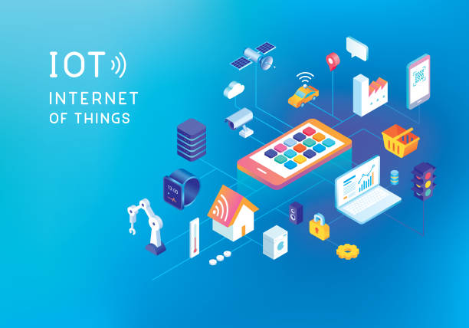
What is IoT ?
Internet of Things (IoT) is a interconnected network of devices which can transfer or receive data over a wireless network without human intervention.
Now what is thing ?
Thing is the physical entity such as Smart light bulb, camera, sensors which has very constrained memory and computing power but capable of exchanging information over the network.
Network can be a Local Area Network or it can be Internet.

Slide 3
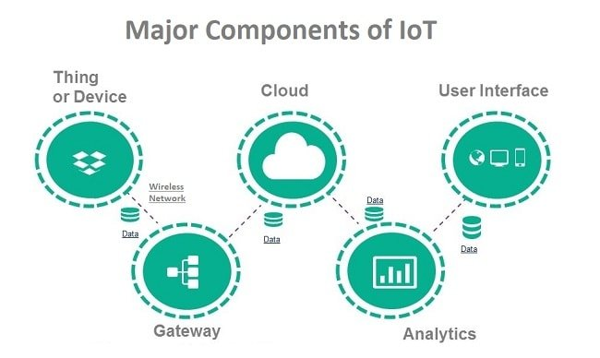
Drivers of IoT
A complete IoT system has four
different components:
Sensors/Things
Connectivity
Data Processing
User interface

Slide 4
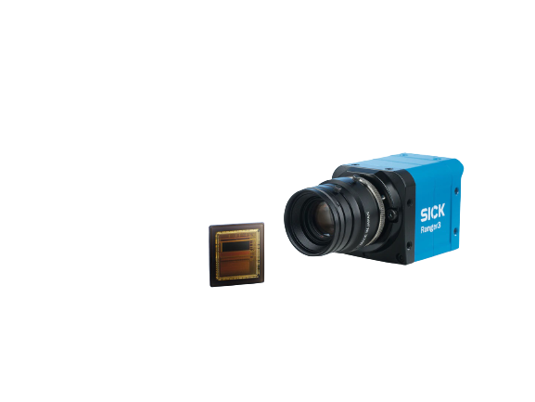
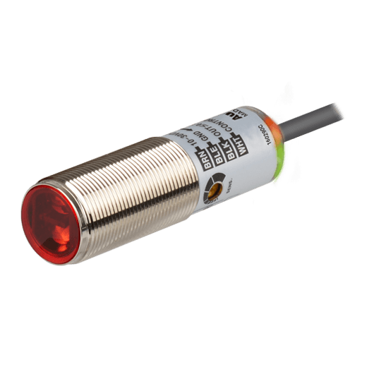
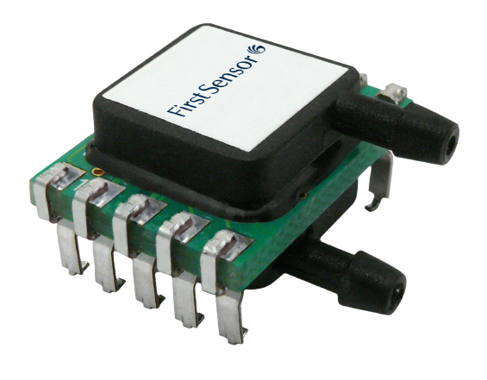
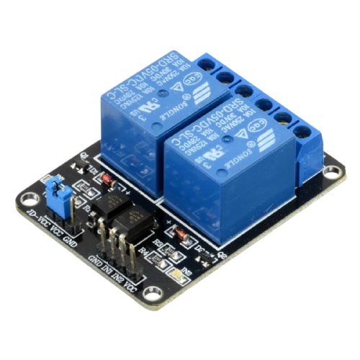
Sensors/Devices
Sensors or devices collect data from their environment.
This could be as simple as a temperature reading or as complex as a full video feed.

Slide 5
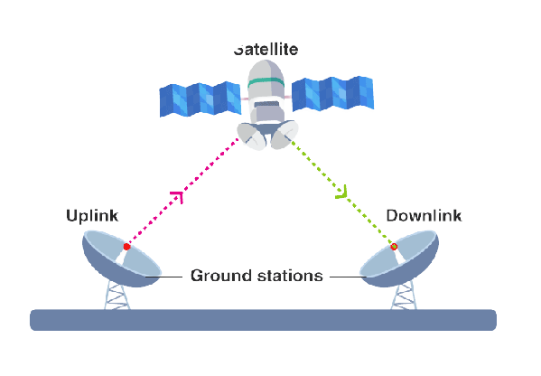
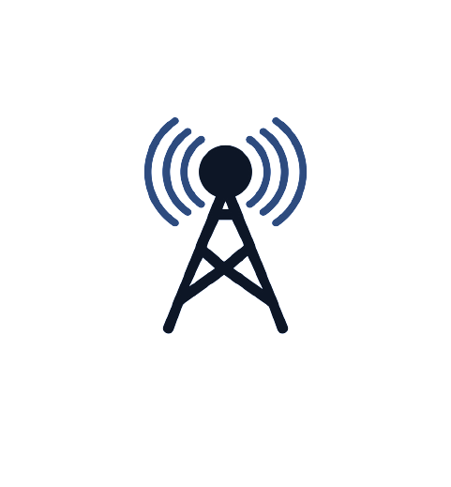

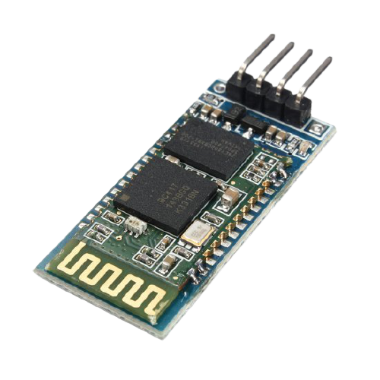
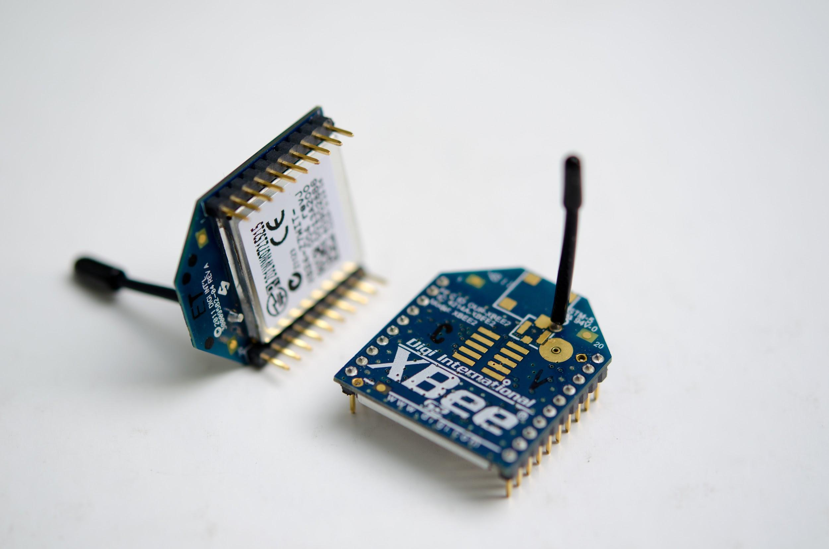
Connectivity
IoT devices are generally short ranged and designed for low power consumption
Most suitable for IoT applications
Greater Range →
Least Power Consumption →

Slide 6
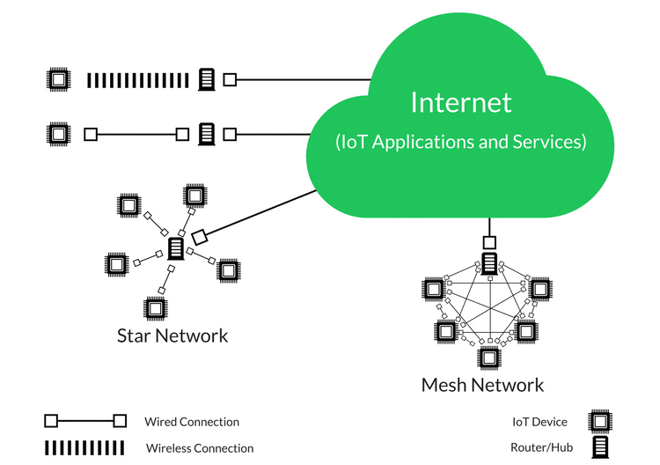
Connectivity
The sensors/devices can be connected to the cloud through a variety of methods including: cellular, satellite, WiFi, Bluetooth or connecting directly to the internet via ethernet.
Zigbee
MQTT

Slide 7
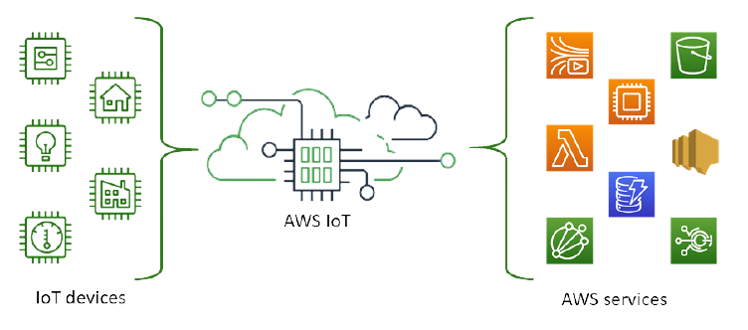
Data Processing

Slide 8
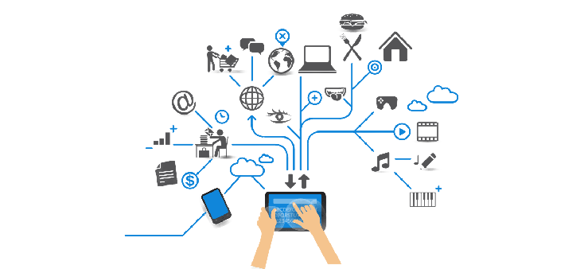
User Interface

Slide 9
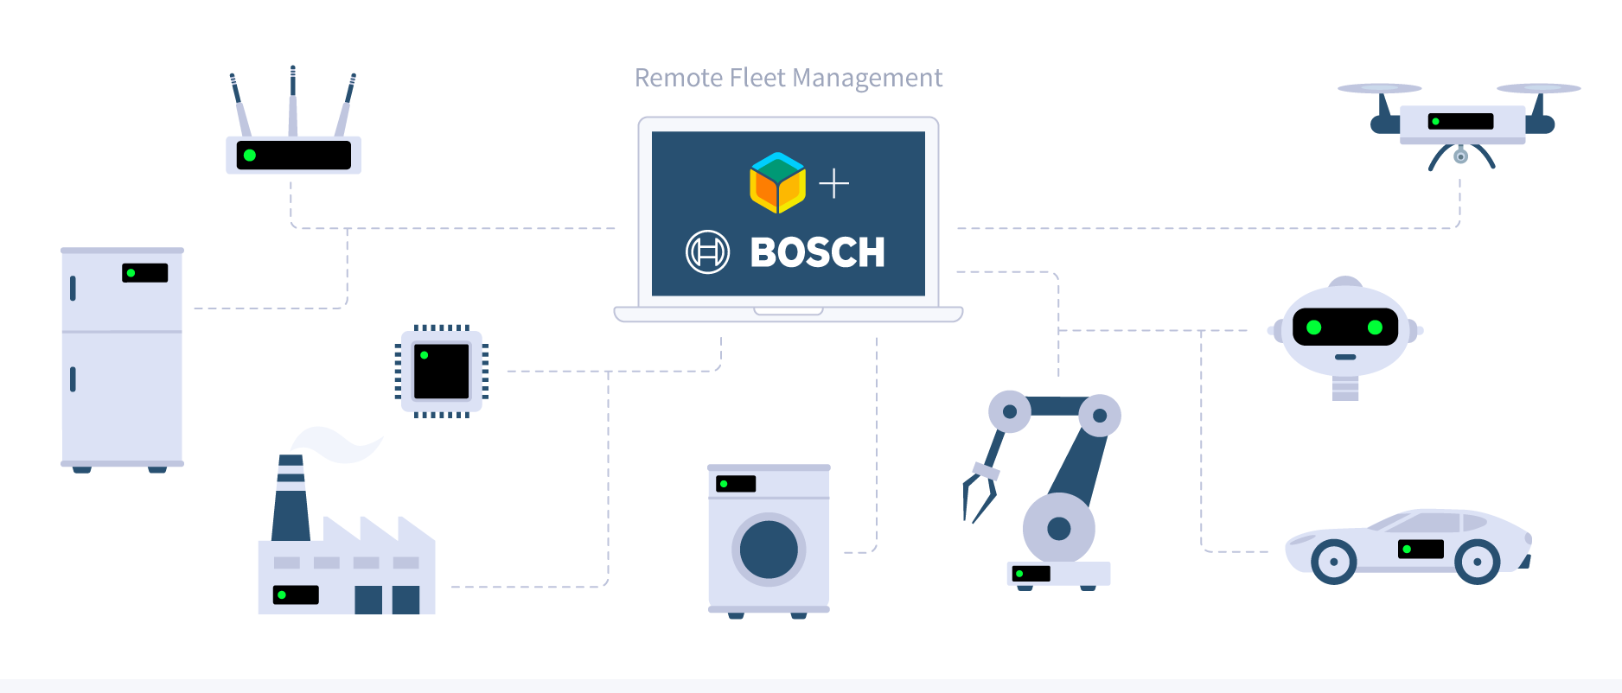
Application of IoT ?
Many companies from different sectors are adopting IoT to simply, improve and automate different processes.
Wearables
Health
Traffic monitoring
Fleet management
Agriculture
Smart grid and energy saving
Maintenance management
Notes:
Yeah, Thanks Vivek!
So lets discuss various applications of IoT.
Many companies from different sectors are adopting IoT to simply, improve and automate different processes.
what this mean is suppose a company made some product, it also embeds some addition IoT device for data collection so it can improve the user experience in their future products.
wearables
agriculture
maintainnece

Slide 10
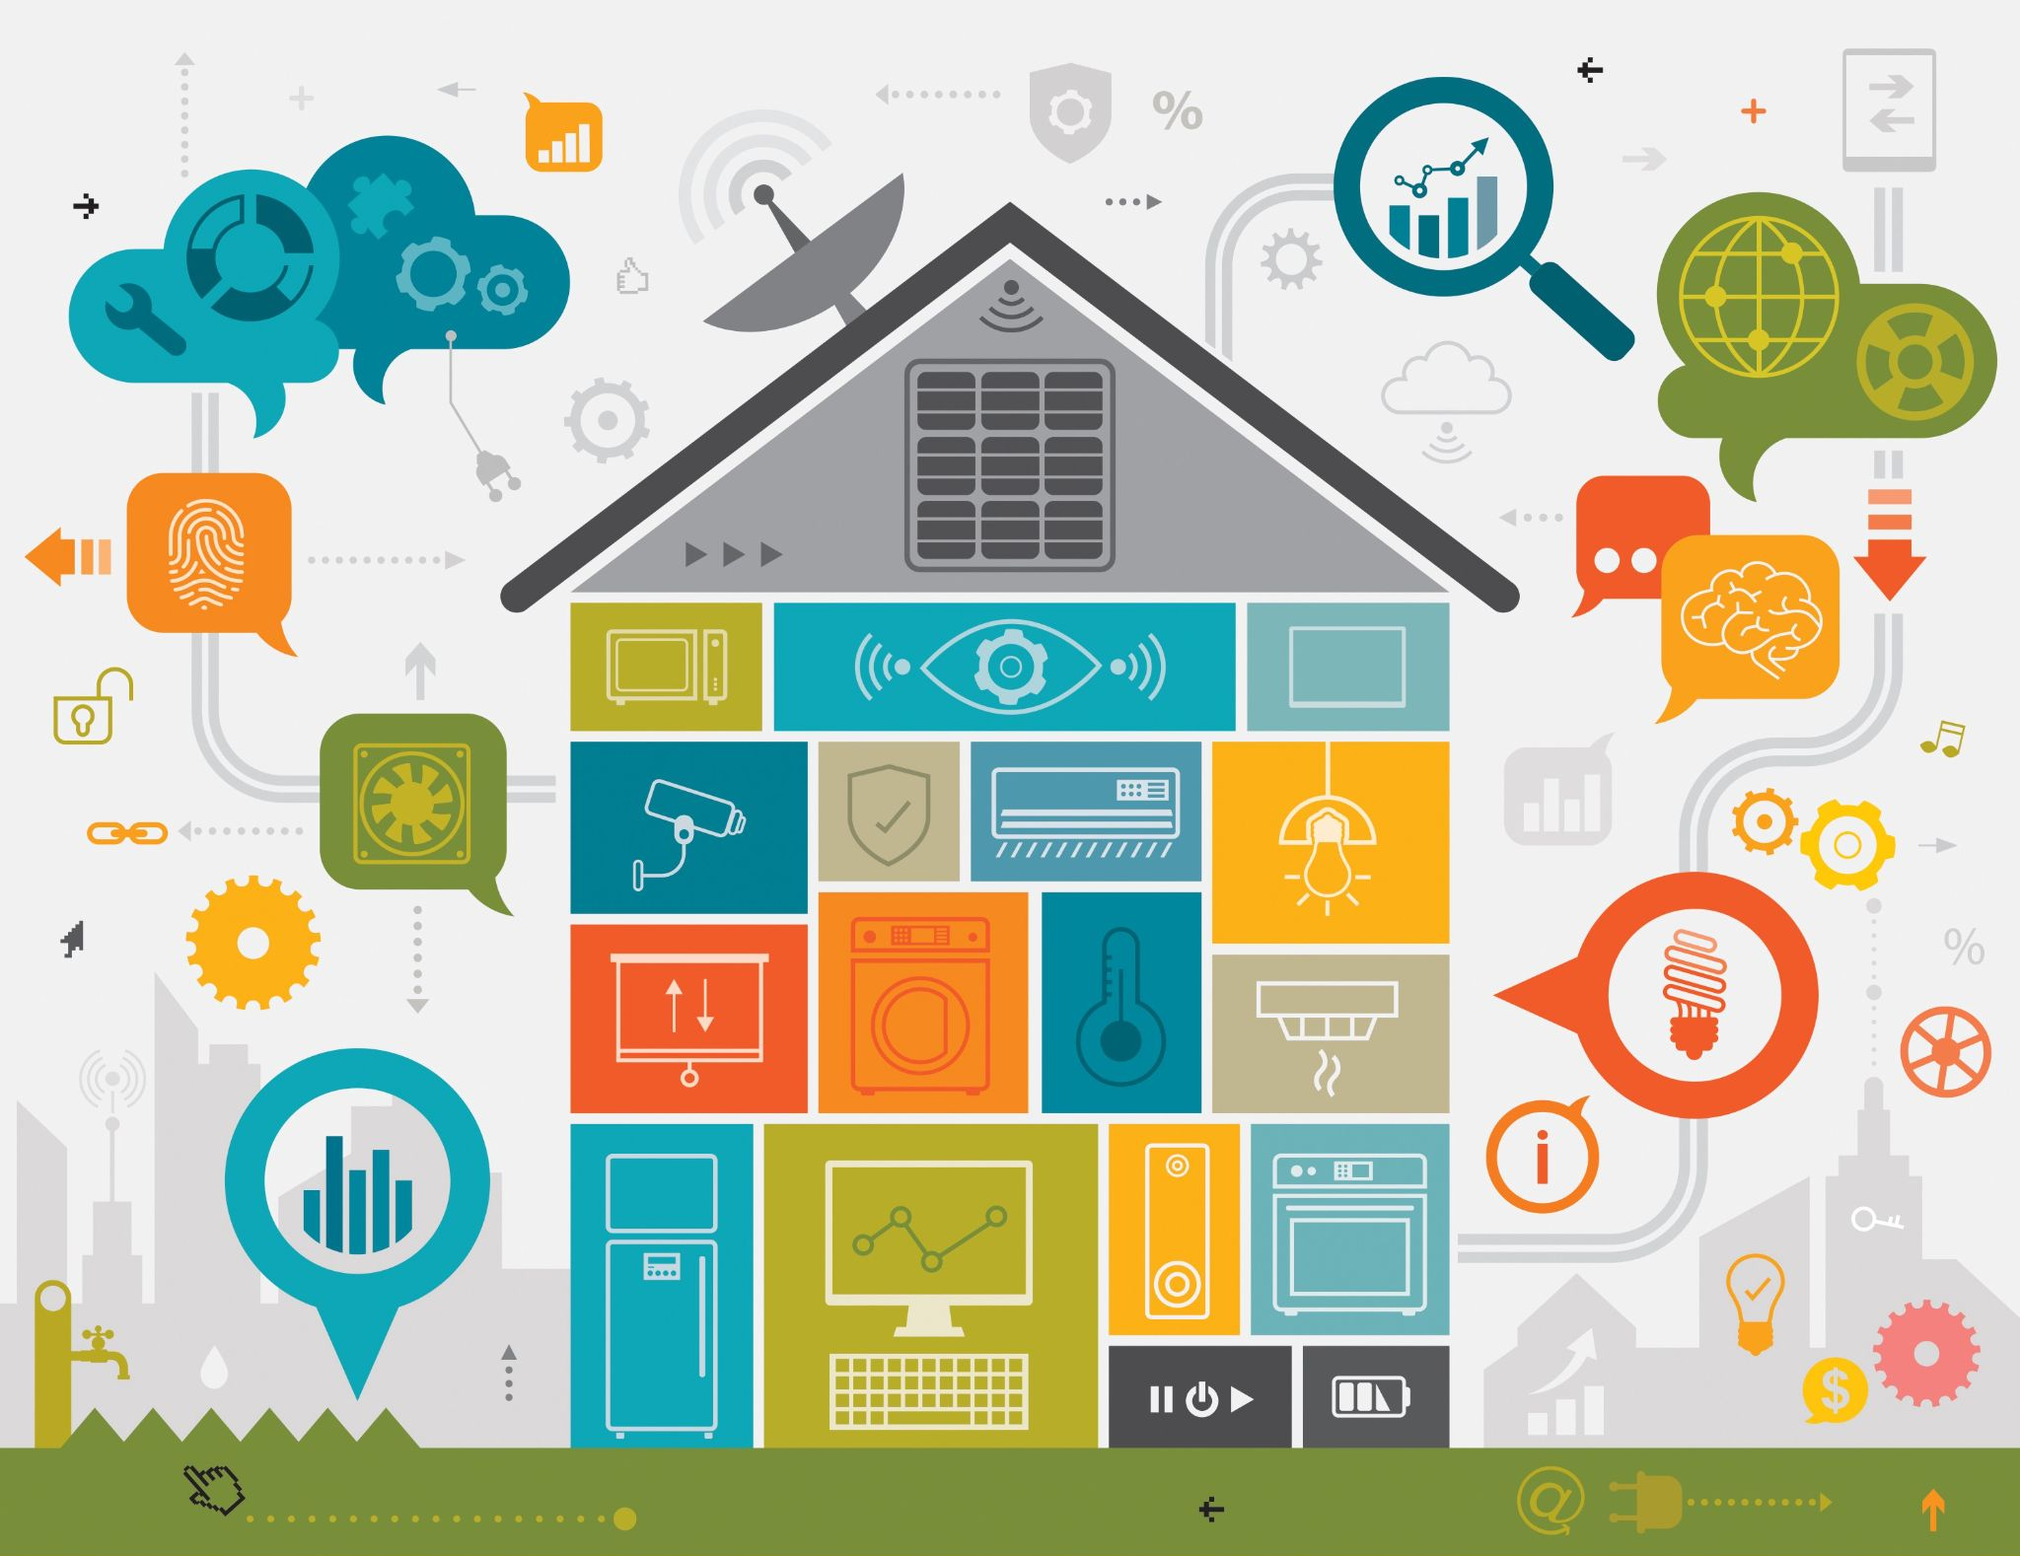
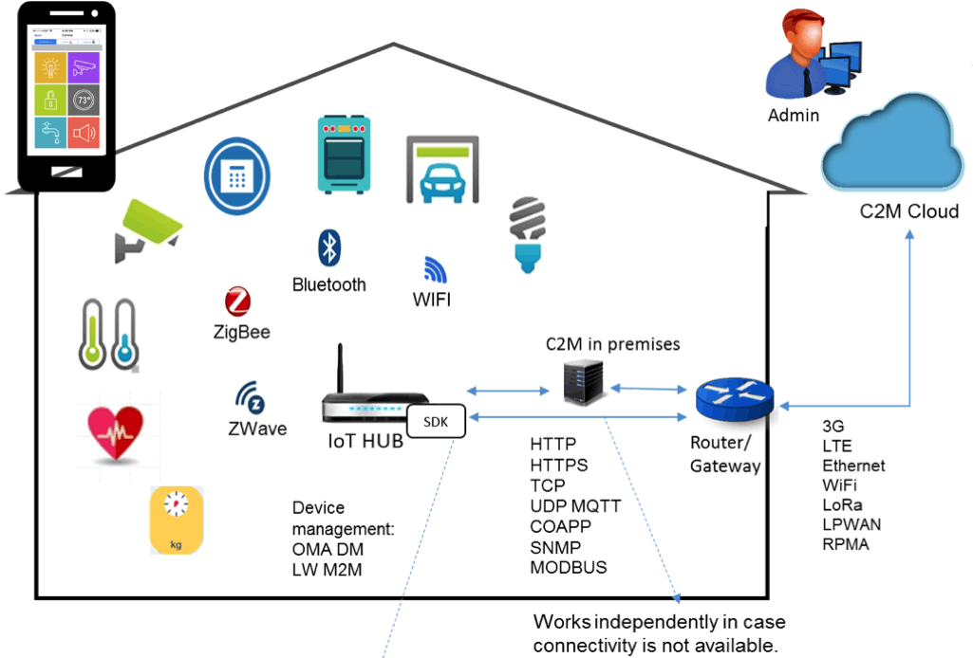
Intelligent Home
Notes:
So next very interesting application is turning your home into intelligent home.
I hopw this concept is not new to you. A intelligent home in a simplistic manner means you are able to controls devices like fans, lights from your phone or something.
so that’s what a lay man definition.
Like I often do is go out of my room without turning off fans and lights.
so, if my home is IoT enBLRED fans would senses
out of town story

Slide 11
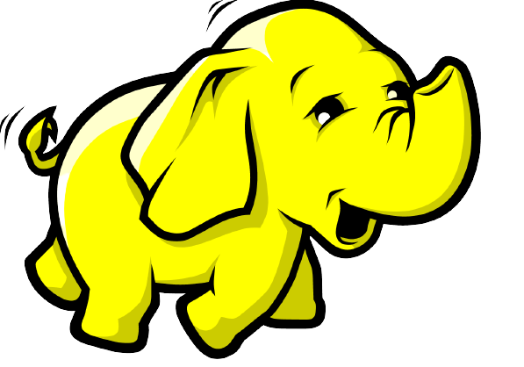
Challenges of IoT
Big Data
Security Challenges
Scalability Challenges
Data volumes and interpretation
Wireless communication
Software complexity
Power Supply
Notes:
one of the biggest challenges is security of user data. since these are small devices with much less computation power they are very much prone to hackers.
And no one wants their data privacy t be breached. soit should be addressed properly to keep IoT industry going.
Next important challenge is data handling, sometimes what happens is when IOT device gets too many requests from end user it many also stop working or give errors.
As far as Power supply is concerned since these are electronic device they consume electric- so it should not create extra burden on power grid.

Slide 12
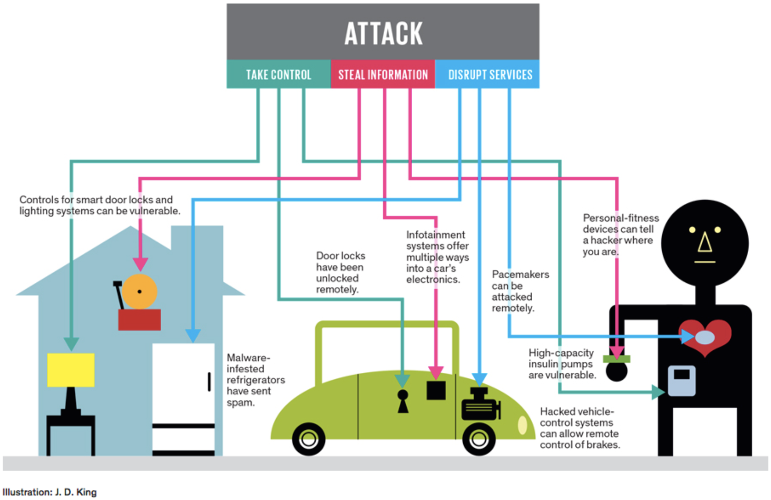
Challenges of IoT
Security!!
Notes:
As discussed above this is pictorial representation of how a hacker may steal your important information and may disrupt important services.

Slide 13
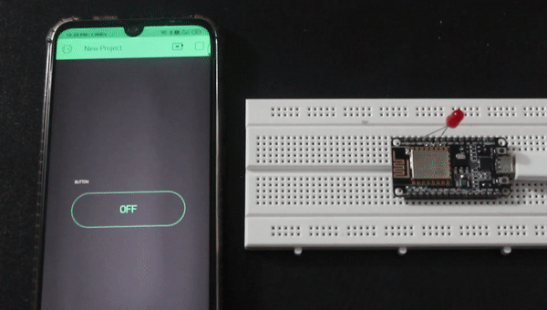
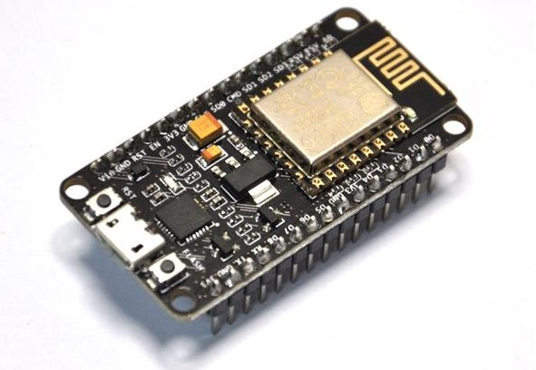
How to get started with IoT
Best methodology is learning by doing: Grab a NodeMCU or ESP8266 module and start exploring it.
A Simple IoT Device - (Just a LED connected to my mobile via cloud)
NodeMCU
Notes:
So, OK great upto this we discussed what is IoT and what is the future potential and challenges associated with it.
Now lets discuss how you can start with IoT. According to me best way is to learn by doing, Grab a NodeMCU or ESP8266 module and start exploring it.
Its a very cheap device which turn almost anything into an IoT device. Its functioning is almost similar to an arduino but with additional wireless capability.
In this GIF you can see its an simple iot device.
Just a LED connected to my mobile via cloud
first year exp
highly recoommend

Slide 14

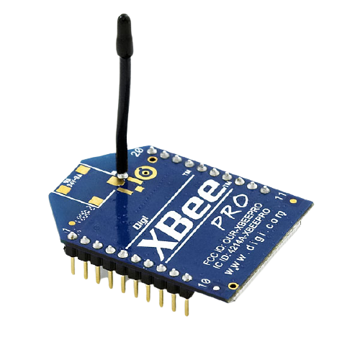
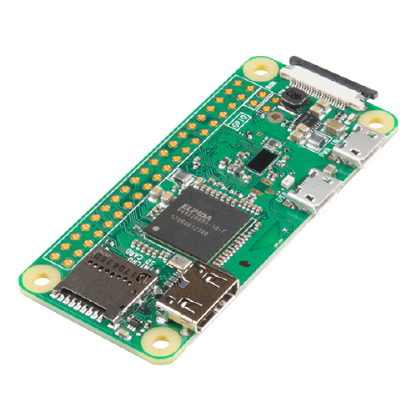
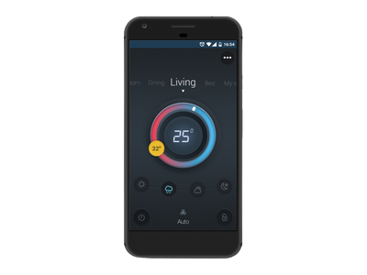
IoT Project
Coordinator
Coordinator
Router
Coordinator
Raspberry pi 0
Coordinator
User Interface

Slide 15
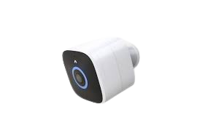
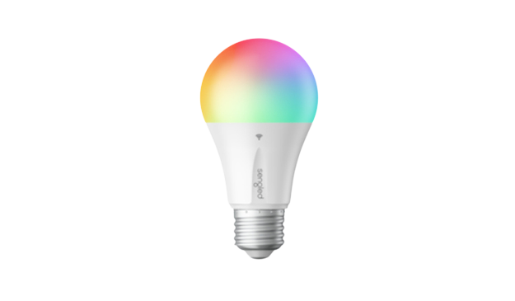
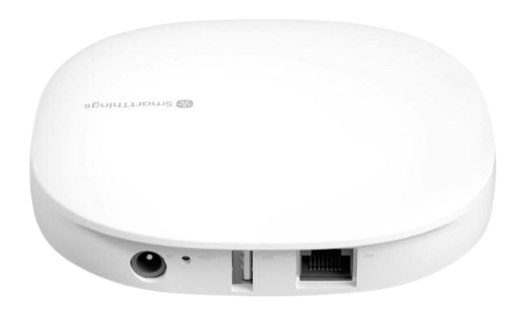
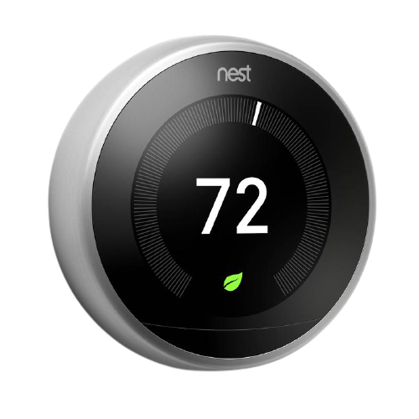
Real Life Example
Samsung IOT Hub

Slide 16
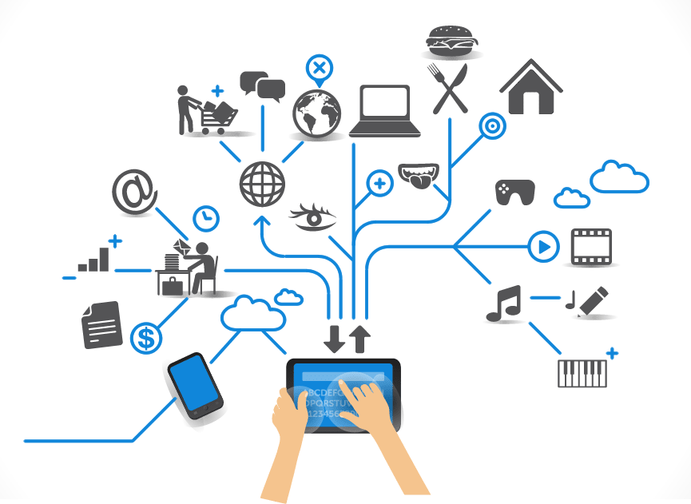
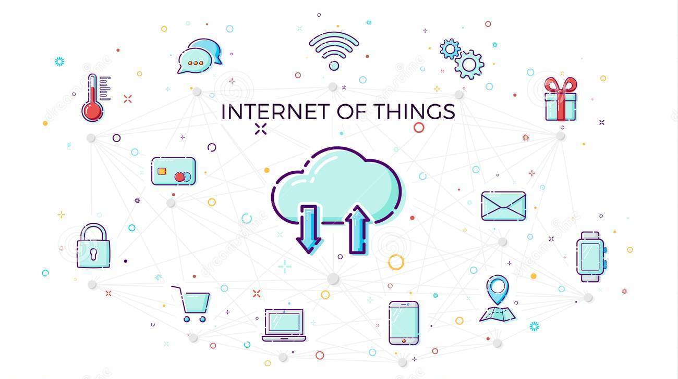
THANK YOU!
Q&A Session

